Slide 1
Multi-Head Self-Attention. Vision Transformers.
Radu Ionescu Bogdan Alexe
raducu.ionescu@gmail.com bogdan.alexe@fmi.unibuc.ro
Faculty of Mathematics and Computer Science
University of Bucharest

Slide 2
Outline
Transformers
Attention in detail
ViT, DINO, CvT, CyTran

Slide 3

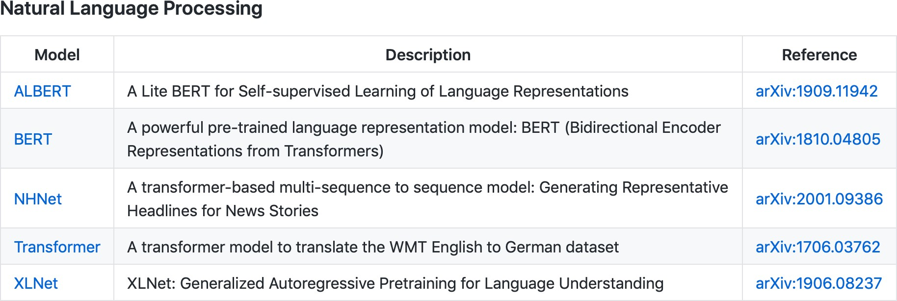
Rise of Transformers

Slide 4
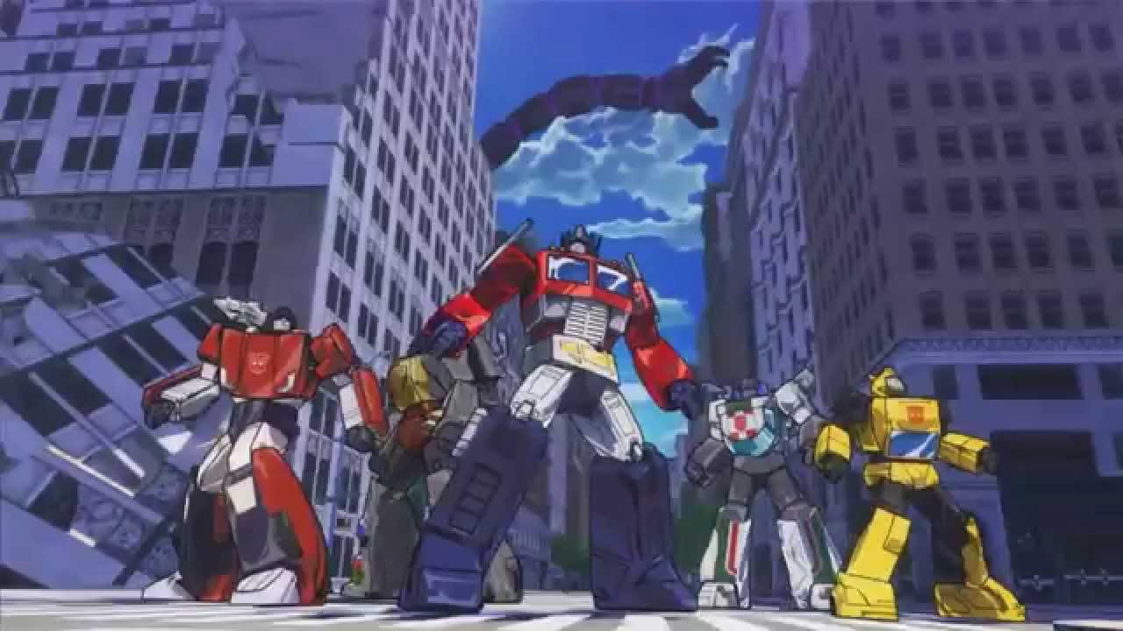
Rise of Transformers

Slide 5
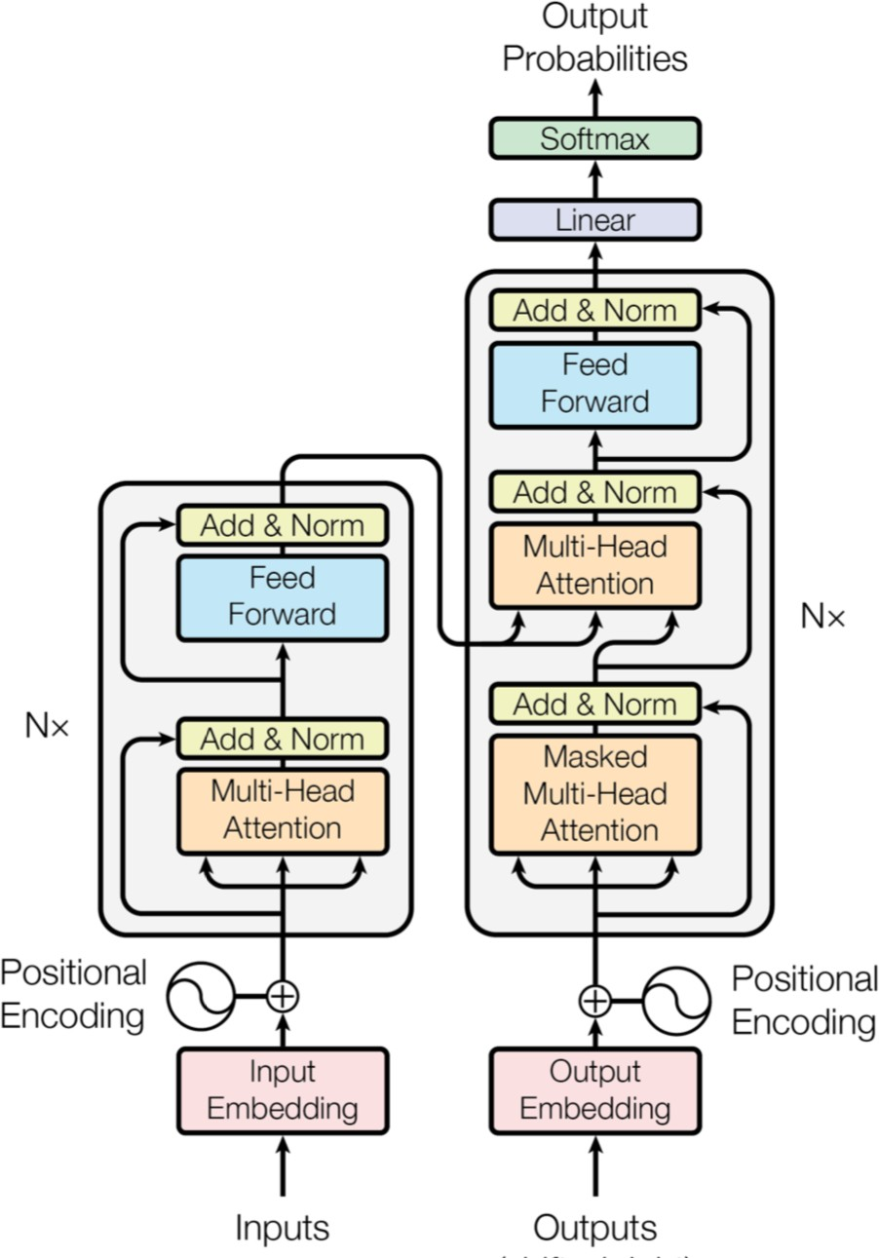
Attention is all you need (2017)
Encoder-decoder with only attention and fully-connected layers (no recurrence or convolutions)
Set new SOTA on translation datasets

Slide 6
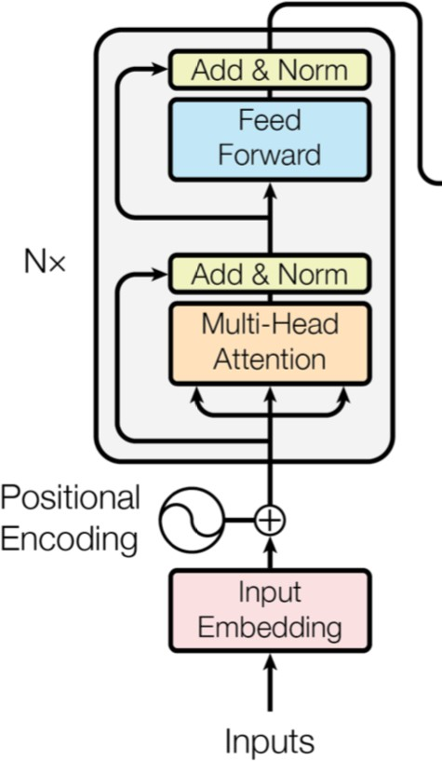
Attention is all you need (2017)
For simplicity, can focus just on the encoder
(e.g. BERT is just the encoder)

Slide 7
Attention is all you need (2017)
The components:
(Masked) Self-attention
Positional encoding
Layer normalization

Slide 8
Outline
Transformers
Attention in detail
ViT, DINO, CvT, CyTran

Slide 9
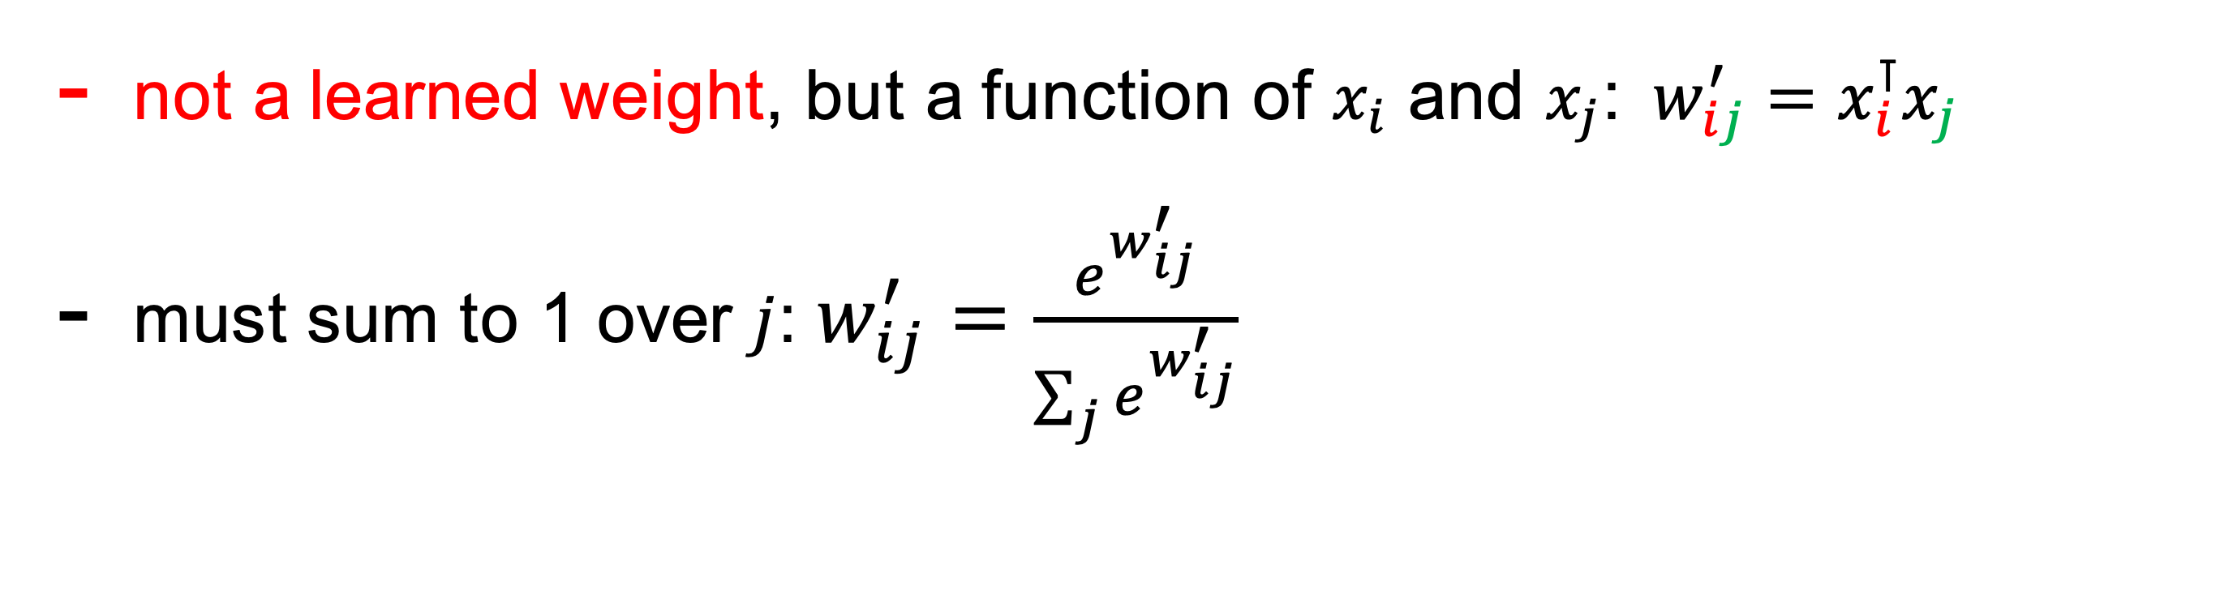
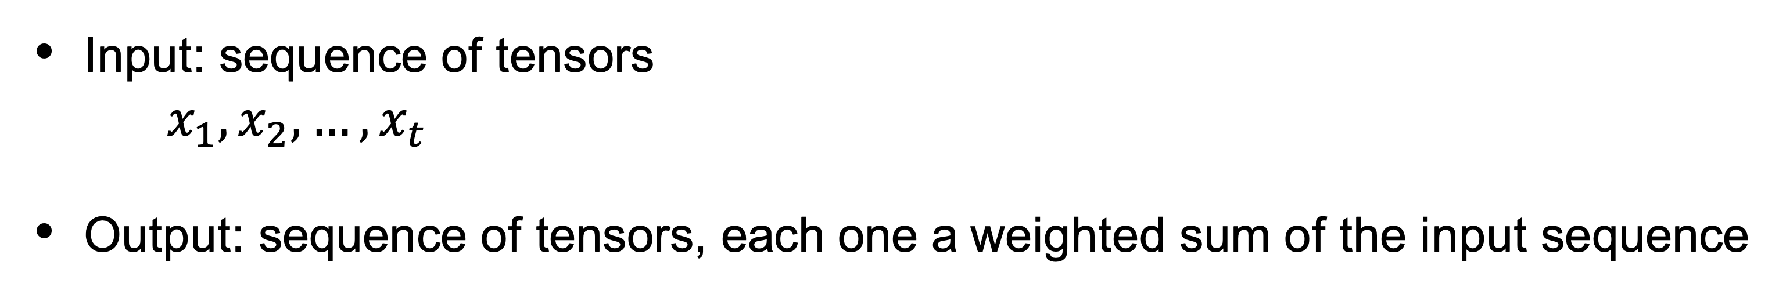
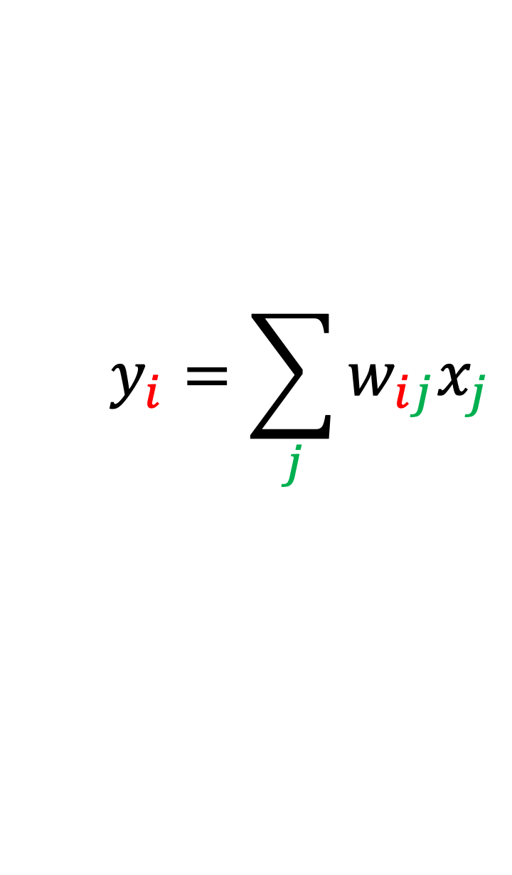
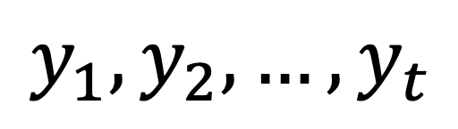
Basic self-attention
Input: sequence of tensors
$x_{1},x_{2},…,x_{t}$
Output: sequence of tensors, each one a weighted sum of the input sequence
$$y_{1},y_{2},…,y_{t}$$
$$y_{i}=\sum_{j}{w_{ij}x_{j}}$$
not a learned weight, but a function of $x_{i}$ and $x_{j}$:$w_{ij}^{′}=x_{i}^{⊺}x_{j}$
must sum to 1 over $j$: $w_{ij}^{′}=\frac{e^{w_{ij}^{′}}}{\sum_{j}{e^{w_{ij}^{′}}}}$
http://www.peterbloem.nl/blog/transformers

Slide 10
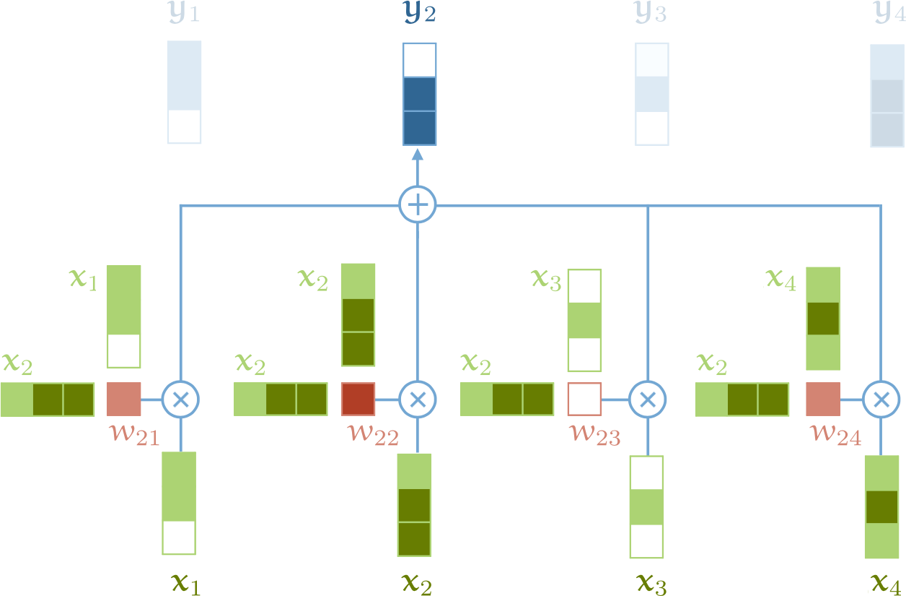
Basic self-attention
The
Cat
is
yawning
http://www.peterbloem.nl/blog/transformers

Slide 11
Basic self-attention
So far:
No learned weights
Order of the sequence does not affect result of computations
http://www.peterbloem.nl/blog/transformers

Slide 12
Basic self-attention
So far:
No learned weights
Let's learn some weights!
Order of the sequence does not affect result of computations
http://www.peterbloem.nl/blog/transformers

Slide 13
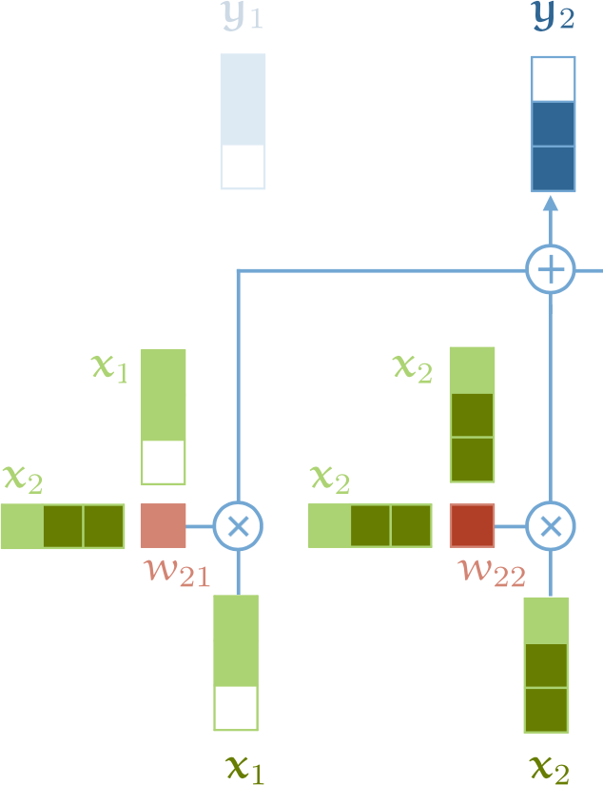
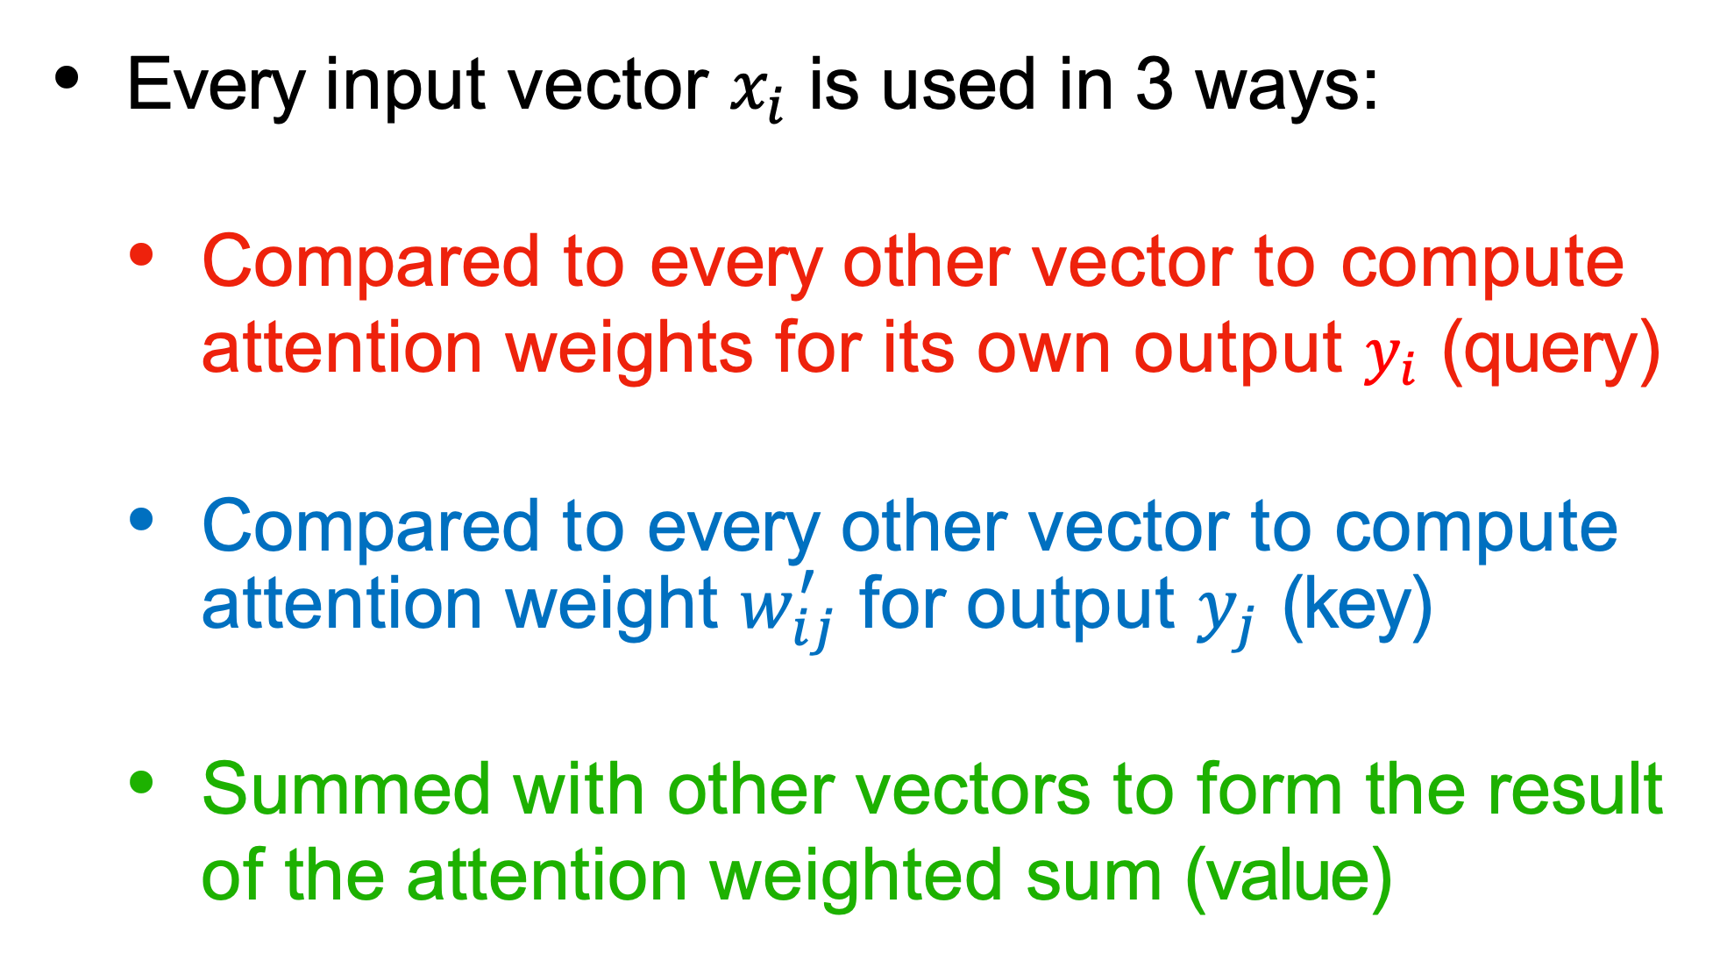
Query, Key, Value
Every input vector $x_{i}$ is used in 3 ways:
Compared to every other vector to compute attention weights for its own output $y_{i}$ (query)
Compared to every other vector to compute attention weight $w_{ij}^{′}$ for output $y_{j}$ (key)
Summed with other vectors to form the result of the attention weighted sum (value)
http://www.peterbloem.nl/blog/transformers

Slide 14
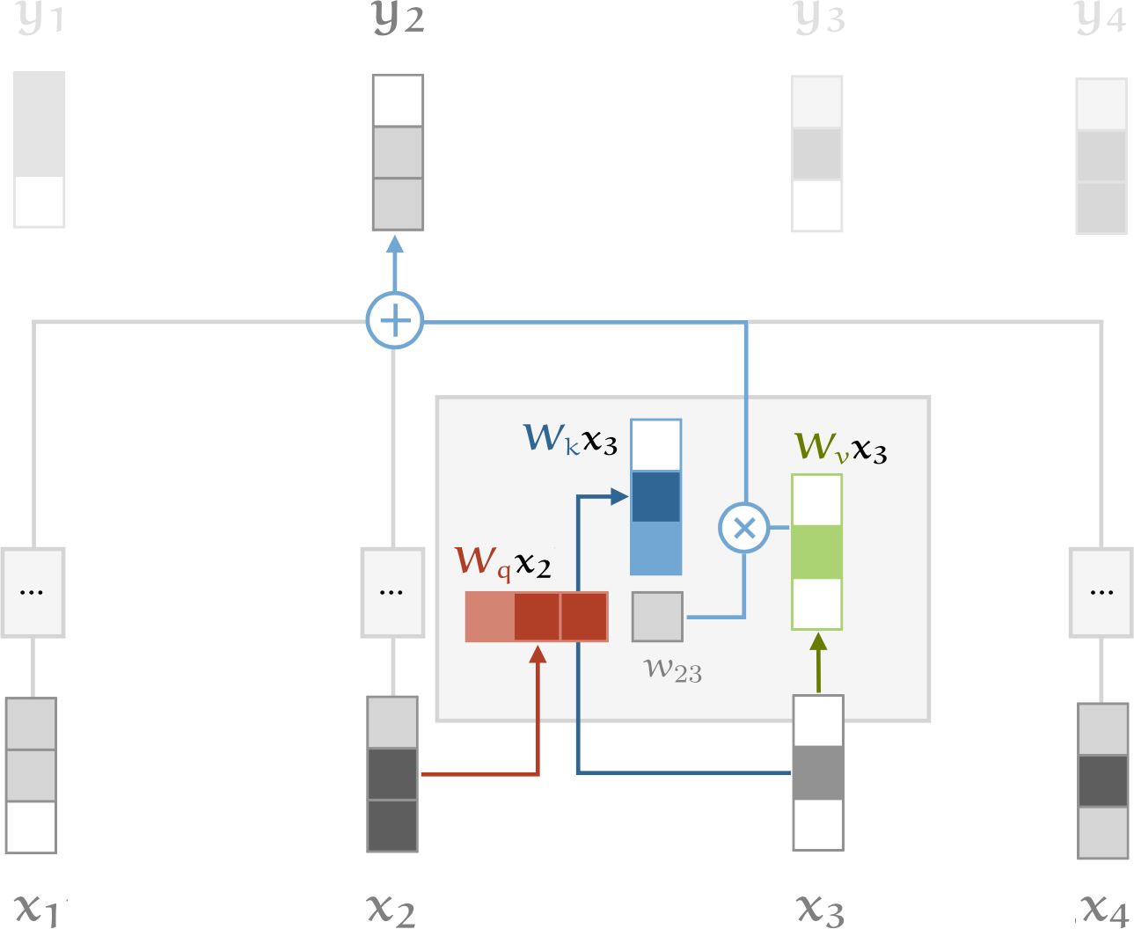


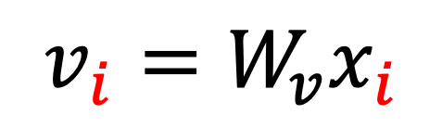
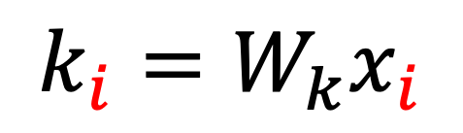
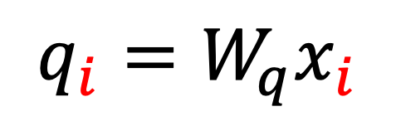

Query, Key, Value
We can process each input vector to fulfill the three roles with matrix multiplication
Learning the matrices => learning attention
$$q_{i}=W_{q}x_{i}$$
$$k_{i}=W_{k}x_{i}$$
$$v_{i}=W_{v}x_{i}$$
$$w_{ij}^{′}=q_{i}^{⊺}k_{j}$$
$$w_{ij}=softmax(w_{ij}^{′})$$
$$y_{i}=\sum_{j}{w_{ij}v_{j}}$$
http://www.peterbloem.nl/blog/transformers

Slide 15









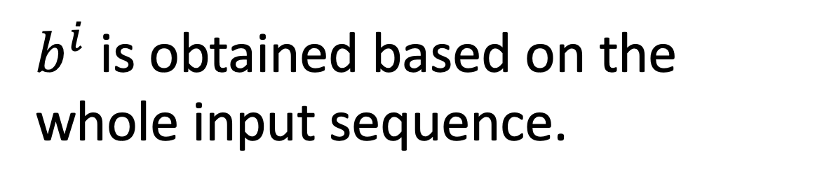





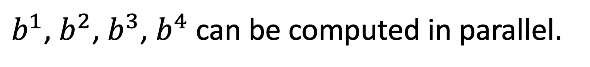



Self-Attention
$b^{i}$ is obtained based on the whole input sequence.
$b^{1}$, $b^{2}$, $b^{3}$, $b^{4}$ can be computed in parallel.
$$b^{1}$$
$$b^{2}$$
$$b^{3}$$
$$b^{4}$$
$$b^{1}$$
$$b^{2}$$
$$b^{3}$$
$$b^{4}$$
Self-Attention Layer
$$a^{1}$$
$$a^{2}$$
$$a^{3}$$
$$a^{4}$$
$$a^{1}$$
$$a^{2}$$
$$a^{3}$$
$$a^{4}$$
You can try to replace any thing that has been done by RNN with self-attention.

Slide 16
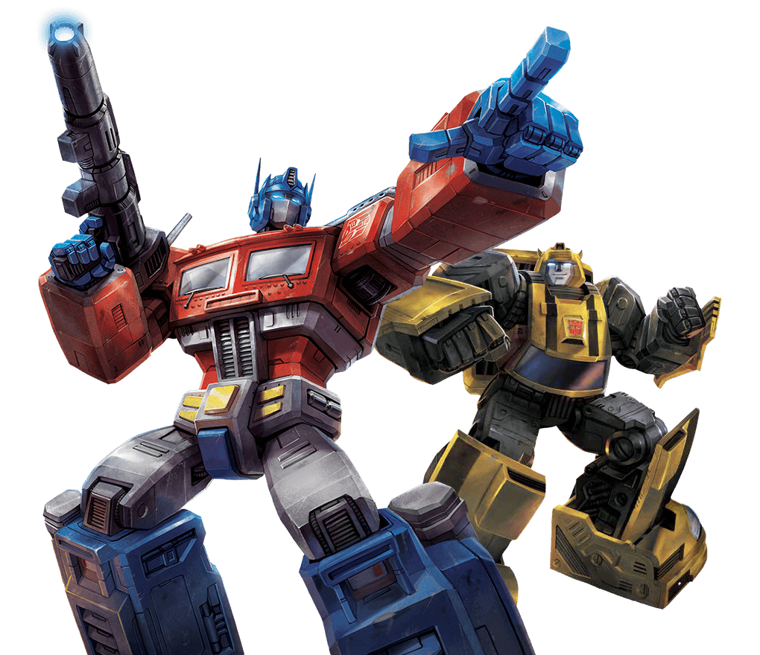


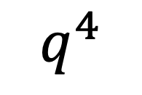
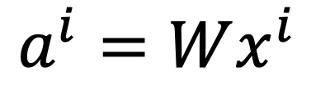



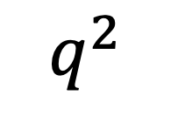

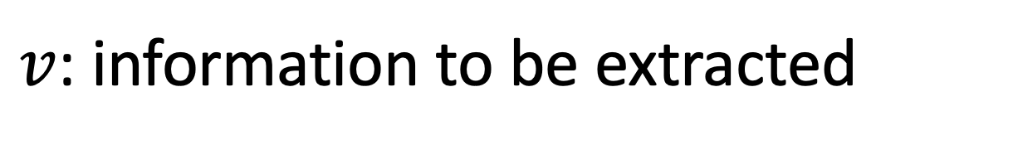

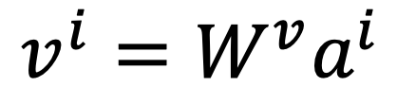


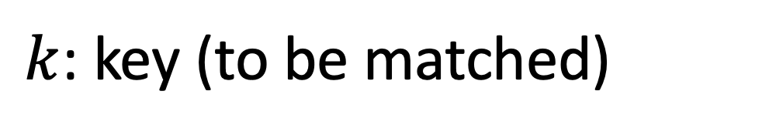











Self-attention
$q$: query (to match others)
https://arxiv.org/abs/1706.03762
$$q^{i}=W^{q}a^{i}$$
$k$: key (to be matched)
$$k^{i}=W^{k}a^{i}$$
Attention is all you need.
$v$: information to be extracted
$$v^{i}=W^{v}a^{i}$$
$$q^{1}$$
$$k^{1}$$
$$v^{1}$$
$$q^{2}$$
$$k^{2}$$
$$v^{2}$$
$$q^{3}$$
$$k^{3}$$
$$v^{3}$$
$$q^{4}$$
$$k^{4}$$
$$v^{4}$$
$$a^{1}$$
$$a^{2}$$
$$a^{3}$$
$$a^{4}$$
$$a^{i}=Wx^{i}$$
$$x^{1}$$
$$x^{2}$$
$$x^{3}$$
$$x^{4}$$

Slide 17






Self-attention
d is the dim of $q$ and $k$
Each query q pays attention to each key k
Scaled Dot-Product Attention:
$$α_{1,i}=q^{1}∙k^{i}/\sqrt{d}$$
dot product
$$α_{1,1}$$
$$α_{1,2}$$
$$α_{1,3}$$
$$α_{1,4}$$
$$q^{1}$$
$$k^{1}$$
$$v^{1}$$
$$q^{2}$$
$$k^{2}$$
$$v^{2}$$
$$q^{3}$$
$$k^{3}$$
$$v^{3}$$
$$q^{4}$$
$$k^{4}$$
$$v^{4}$$
$$a^{1}$$
$$a^{2}$$
$$a^{3}$$
$$a^{4}$$
$$x^{1}$$
$$x^{2}$$
$$x^{3}$$
$$x^{4}$$

Slide 18





Self-attention
$${\hat{α}}_{1,i}=exp\left(α_{1,i} \right)/\sum_{j}{exp\left(α_{1,j} \right)}$$
$${\hat{α}}_{1,1}$$
$${\hat{α}}_{1,2}$$
$${\hat{α}}_{1,3}$$
$${\hat{α}}_{1,4}$$
Softmax
$$α_{1,1}$$
$$α_{1,2}$$
$$α_{1,3}$$
$$α_{1,4}$$
$$q^{1}$$
$$k^{1}$$
$$v^{1}$$
$$q^{2}$$
$$k^{2}$$
$$v^{2}$$
$$q^{3}$$
$$k^{3}$$
$$v^{3}$$
$$q^{4}$$
$$k^{4}$$
$$v^{4}$$
$$a^{1}$$
$$a^{2}$$
$$a^{3}$$
$$a^{4}$$
$$x^{1}$$
$$x^{2}$$
$$x^{3}$$
$$x^{4}$$

Slide 19






Self-attention
$$b^{1}=\sum_{i}{{\hat{α}}_{1,i}v^{i} }$$
Considering the whole sequence
$$b^{1}$$
$${\hat{α}}_{1,1}$$
$${\hat{α}}_{1,2}$$
$${\hat{α}}_{1,3}$$
$${\hat{α}}_{1,4}$$
$$q^{1}$$
$$k^{1}$$
$$v^{1}$$
$$q^{2}$$
$$k^{2}$$
$$v^{2}$$
$$q^{3}$$
$$k^{3}$$
$$v^{3}$$
$$q^{4}$$
$$k^{4}$$
$$v^{4}$$
$$a^{1}$$
$$a^{2}$$
$$a^{3}$$
$$a^{4}$$
$$x^{1}$$
$$x^{2}$$
$$x^{3}$$
$$x^{4}$$
Notes:
Relation between attention and CNN
Global receptive field (compared to convolutional architectures)

Slide 20






Self-attention
$$b^{2}=\sum_{i}{{\hat{α}}_{2,i}v^{i} }$$
Each query q pays attention to each key k
$$b^{2}$$
$${\hat{α}}_{2,1}$$
$${\hat{α}}_{2,2}$$
$${\hat{α}}_{2,3}$$
$${\hat{α}}_{2,4}$$
$$q^{1}$$
$$k^{1}$$
$$v^{1}$$
$$q^{2}$$
$$k^{2}$$
$$v^{2}$$
$$q^{3}$$
$$k^{3}$$
$$v^{3}$$
$$q^{4}$$
$$k^{4}$$
$$v^{4}$$
$$a^{1}$$
$$a^{2}$$
$$a^{3}$$
$$a^{4}$$
$$x^{1}$$
$$x^{2}$$
$$x^{3}$$
$$x^{4}$$
Notes:
Relation between attention and CNN
Global receptive field (compared to convolutional architectures)

Slide 21





Self-attention
$b^{1}$, $b^{2}$, $b^{3}$, $b^{4}$ can be computed in parallel.
$$b^{1}$$
$$b^{2}$$
$$b^{3}$$
$$b^{4}$$
Self-Attention Layer
$$a^{1}$$
$$a^{2}$$
$$a^{3}$$
$$a^{4}$$
$$x^{1}$$
$$x^{2}$$
$$x^{3}$$
$$x^{4}$$
Notes:
Relation between attention and CNN
Global receptive field (compared to convolutional architectures)

Slide 22






























Self-attention
$$q^{1}$$
$$q^{2}$$
$$q^{3}$$
$$q^{4}$$
$$a^{1}$$
$$a^{2}$$
=
$$a^{3}$$
$$W^{q}$$
$$a^{4}$$
$$Q$$
$$I$$
$$a^{1}$$
$$a^{2}$$
$$k^{1}$$
$$a^{3}$$
$$k^{2}$$
$$a^{4}$$
$$k^{3}$$
$$q^{i}=W^{q}a^{i}$$
$$k^{4}$$
=
$$W^{k}$$
$$K$$
$$I$$
$$k^{i}=W^{k}a^{i}$$
$$a^{1}$$
$$a^{2}$$
$$a^{3}$$
$$v^{1}$$
$$a^{4}$$
$$v^{2}$$
$$v^{3}$$
$$v^{4}$$
=
$$W^{v}$$
$$v^{i}=W^{v}a^{i}$$
$$V$$
$$I$$
$$q^{1}$$
$$k^{1}$$
$$v^{1}$$
$$q^{2}$$
$$k^{2}$$
$$v^{2}$$
$$q^{3}$$
$$k^{3}$$
$$v^{3}$$
$$q^{4}$$
$$k^{4}$$
$$v^{4}$$
$$a^{1}$$
$$a^{2}$$
$$a^{3}$$
$$a^{4}$$
$$x^{1}$$
$$x^{2}$$
$$x^{3}$$
$$x^{4}$$

Slide 23





















Self-attention
$$b^{1}$$
$${\hat{α}}_{1,1}$$
$${\hat{α}}_{1,2}$$
$${\hat{α}}_{1,3}$$
$${\hat{α}}_{1,4}$$
$$q^{1}$$
$$k^{1}$$
$$v^{1}$$
$$q^{2}$$
$$k^{2}$$
$$v^{2}$$
$$q^{3}$$
$$k^{3}$$
$$v^{3}$$
$$q^{4}$$
$$k^{4}$$
$$v^{4}$$
$$α_{1,1}=$$
$$k^{1}$$
$$q^{1}$$
$$α_{1,2}=$$
$$k^{2}$$
$$q^{1}$$
$$α_{1,1}$$
$$k^{1}$$
$$α_{1,2}$$
$$k^{2}$$
$$α_{1,3}=$$
$$k^{3}$$
$$q^{1}$$
$$α_{1,4}=$$
$$k^{4}$$
$$q^{1}$$
$$=$$
$$q^{1}$$
$$α_{1,3}$$
$$k^{3}$$
$$α_{1,4}$$
$$k^{4}$$
(ignore $\sqrt{d}$ for simplicity)
Notes:
Relation between attention and CNN
Global receptive field (compared to convolutional architectures)

Slide 24













































Self-attention
$$b^{2}=\sum_{i}{{\hat{α}}_{2,i}v^{i} }$$
$$b^{2}$$
$${\hat{α}}_{2,1}$$
$${\hat{α}}_{2,2}$$
$${\hat{α}}_{2,3}$$
$${\hat{α}}_{2,4}$$
$$q^{1}$$
$$k^{1}$$
$$v^{1}$$
$$q^{2}$$
$$k^{2}$$
$$v^{2}$$
$$q^{3}$$
$$k^{3}$$
$$v^{3}$$
$$q^{4}$$
$$k^{4}$$
$$v^{4}$$
$${\hat{α}}_{1,1}$$
$${\hat{α}}_{2,1}$$
$${\hat{α}}_{3,1}$$
$${\hat{α}}_{4,1}$$
$$α_{1,1}$$
$$α_{2,1}$$
$$α_{3,1}$$
$$α_{4,1}$$
$$k^{1}$$
$${\hat{α}}_{1,2}$$
$${\hat{α}}_{2,2}$$
$${\hat{α}}_{3,2}$$
$${\hat{α}}_{4,2}$$
$$α_{1,2}$$
$$α_{2,2}$$
$$α_{3,2}$$
$$α_{4,2}$$
$$k^{2}$$
$${\hat{α}}_{1,3}$$
$${\hat{α}}_{2,3}$$
$${\hat{α}}_{3,3}$$
$$=$$
$$q^{1}$$
$$q^{2}$$
$$q^{3}$$
$$q^{4}$$
$${\hat{α}}_{4,3}$$
$$α_{1,3}$$
$$α_{2,3}$$
$$α_{3,3}$$
$$α_{4,3}$$
$$k^{3}$$
$${\hat{α}}_{1,4}$$
$${\hat{α}}_{2,4}$$
$${\hat{α}}_{3,4}$$
$${\hat{α}}_{4,4}$$
$$α_{1,4}$$
$$α_{2,4}$$
$$α_{3,4}$$
$$α_{4,4}$$
$$k^{4}$$
$$Q$$
$$\hat{A}$$
$$A$$
$$K^{T}$$
Notes:
Relation between attention and CNN
Global receptive field (compared to convolutional architectures)

Slide 25

























Self-attention
$$b^{2}=\sum_{i}{{\hat{α}}_{2,i}v^{i} }$$
$$b^{2}$$
$${\hat{α}}_{2,1}$$
$${\hat{α}}_{2,2}$$
$${\hat{α}}_{2,3}$$
$${\hat{α}}_{2,4}$$
$$q^{1}$$
$$k^{1}$$
$$v^{1}$$
$$q^{2}$$
$$k^{2}$$
$$v^{2}$$
$$q^{3}$$
$$k^{3}$$
$$v^{3}$$
$$q^{4}$$
$$k^{4}$$
$$v^{4}$$
$${\hat{α}}_{1,1}$$
$${\hat{α}}_{2,1}$$
$${\hat{α}}_{3,1}$$
$${\hat{α}}_{4,1}$$
$${\hat{α}}_{1,2}$$
$${\hat{α}}_{2,2}$$
$${\hat{α}}_{3,2}$$
$${\hat{α}}_{4,2}$$
$$b^{1}$$
=
$$b^{2}$$
$$b^{3}$$
$$b^{4}$$
$$v^{1}$$
$$v^{2}$$
$$v^{3}$$
$$v^{4}$$
$${\hat{α}}_{1,3}$$
$${\hat{α}}_{2,3}$$
$${\hat{α}}_{3,3}$$
$${\hat{α}}_{4,3}$$
$$O$$
$$V$$
$${\hat{α}}_{1,4}$$
$${\hat{α}}_{2,4}$$
$${\hat{α}}_{3,4}$$
$${\hat{α}}_{4,4}$$
$$\hat{A}$$
Notes:
Relation between attention and CNN
Global receptive field (compared to convolutional architectures)

Slide 26



















Self-attention
$$O$$
$$Q$$
=
$$I$$
$$W^{q}$$
$$K$$
=
$$I$$
$$W^{k}$$
$$V$$
=
$$I$$
$$I$$
$$W^{v}$$
$$\hat{A}$$
$$A$$
=
$$Q$$
$$K^{T}$$
$$\hat{A}$$
$$O$$
=
$$V$$
A bunch of matrix multiplications, which can be executed efficiently on GPUs

Slide 27


Multi-head attention
Multiple "heads" of attention just means learning different sets of $W_{q}$, $W_{k}$, and $W_{v}$ matrices simultaneously.
Implemented as just a single matrix anyway...
http://www.peterbloem.nl/blog/transformers

Slide 28
























Multi-head Self-attention
(2 heads as example)
$$q^{i,1}=W^{q,1}q^{i}$$
$$b^{i,1}$$
$$q^{i,2}=W^{q,2}q^{i}$$
$$q^{i,1}$$
$$q^{i,2}$$
$$k^{i,1}$$
$$k^{i,2}$$
$$v^{i,1}$$
$$v^{i,2}$$
$$q^{j,1}$$
$$q^{j,2}$$
$$k^{j,1}$$
$$k^{j,2}$$
$$v^{j,1}$$
$$v^{j,2}$$
$$q^{i}$$
$$k^{i}$$
$$v^{i}$$
$$q^{j}$$
$$k^{j}$$
$$v^{j}$$
$$q^{i}=W^{q}a^{i}$$
$$a^{i}$$
$$a^{j}$$

Slide 29


Multi-head Self-attention
(2 heads as example)
$$q^{i,1}=W^{q,1}q^{i}$$
$$b^{i,1}$$
$$q^{i,2}=W^{q,2}q^{i}$$
$$b^{i,2}$$
$$q^{i,1}$$
$$q^{i,2}$$
$$k^{i,1}$$
$$k^{i,2}$$
$$v^{i,1}$$
$$v^{i,2}$$
$$q^{j,1}$$
$$q^{j,2}$$
$$k^{j,1}$$
$$k^{j,2}$$
$$v^{j,1}$$
$$v^{j,2}$$
$$q^{i}$$
$$k^{i}$$
$$v^{i}$$
$$q^{j}$$
$$k^{j}$$
$$v^{j}$$
$$q^{i}=W^{q}x^{i}$$
$$a^{i}$$
$$a^{j}$$

Slide 30





Multi-head Self-attention
(2 heads as example)
$$b^{i,1}$$
$$b^{i}$$
$$b^{i,1}$$
$$b^{i,2}$$
$$b^{i}$$
=
$$W^{O}$$
$$b^{i,2}$$
$$q^{i,1}$$
$$q^{i,2}$$
$$k^{i,1}$$
$$k^{i,2}$$
$$v^{i,1}$$
$$v^{i,2}$$
$$q^{j,1}$$
$$q^{j,2}$$
$$k^{j,1}$$
$$k^{j,2}$$
$$v^{j,1}$$
$$v^{j,2}$$
$$q^{i}$$
$$k^{i}$$
$$v^{i}$$
$$q^{j}$$
$$k^{j}$$
$$v^{j}$$
$$a^{i}$$
$$a^{j}$$

Slide 31

Transformer
Self-attention layer => Layer normalization => Dense layer
http://www.peterbloem.nl/blog/transformers

Slide 32
Transformer
Self-attention layer => Layer normalization => Dense layer
http://www.peterbloem.nl/blog/transformers

Slide 33



Layer Normalization
Neural net layers work best when input vectors have uniform mean and std in each dimension
remember input data scaling, weight initialization
As inputs flow through the network, means and std's get blown out
Layer Normalization is a hack to reset things to where we want them in between layers
https://arxiv.org/pdf/1803.08494.pdf

Slide 34
Transformer
Self-attention layer => Layer normalization => Dense layer
http://www.peterbloem.nl/blog/transformers

Slide 35
Transformer
So far:
Learned query, key, value weights
Multiple heads
Order of the sequence does not affect result of computations
http://www.peterbloem.nl/blog/transformers

Slide 36
Transformer
So far:
Learned query, key, value weights
Multiple heads
Order of the sequence does not affect result of computations
Let's encode each vector with position
http://www.peterbloem.nl/blog/transformers

Slide 37


















Positional Encoding
$$q^{i}$$
$$k^{i}$$
$$v^{i}$$
$$e^{i}$$
+
$$a^{i}$$
No position information in self-attention.
Original paper: each position has a unique positional vector $e^{i}$ (not learned from data)
In other words: each $x^{i}$ appends a one-hot vector $p^{i}$
$$x^{i}$$
$$x^{i}$$
$$a^{i}$$
$$W$$
=
$$W^{I}$$
$$x^{i}$$
$$p^{i}$$
$$W^{I}$$
$$W^{P}$$
$$p^{i}=$$
0
………
$$e^{i}$$
1
i-th dim
$$W^{P}$$
+
$$p^{i}$$
0
…

Slide 38













$$x^{i}$$
$$W$$
$$p^{i}$$
$$W^{I}$$
$$W^{P}$$
$$a^{i}$$
=
$$W^{I}$$
$$x^{i}$$
$$e^{i}$$
+
$$W^{P}$$
$$p^{i}$$
-1
1
source of image: http://jalammar.github.io/illustrated-transformer/

Slide 39


Transformer
http://www.peterbloem.nl/blog/transformers

Slide 40


Transformer
Position embedding: just what it sounds!
http://www.peterbloem.nl/blog/transformers

Slide 41

Transformer: last trick
Since the Transformer sees all inputs at once, to predict next vector in sequence (e.g. generate text), we need to mask the future.
http://www.peterbloem.nl/blog/transformers

Slide 42

Transformer: last trick
Since the Transformer sees all inputs at once, to predict next vector in sequence (e.g. generate text), we need to mask the future.
http://www.peterbloem.nl/blog/transformers

Slide 43















Seq2seq with Attention
Review: https://www.youtube.com/watch?v=ZjfjPzXw6og&feature=youtu.be
$$c^{1}$$
$$c^{2}$$
$$o^{1}$$
$$o^{2}$$
$$o^{3}$$
$$h^{1}$$
$$h^{2}$$
$$h^{3}$$
$$h^{4}$$
Self-Attention Layer
Self-Attention Layer
$$x^{1}$$
$$x^{2}$$
$$x^{3}$$
$$x^{4}$$
$$c^{1}$$
$$c^{2}$$
$$c^{3}$$
Encoder
Decoder

Slide 44
Outline
Transformers
Attention in detail
ViT, DINO, CvT, CyTran

Slide 45
An image is worth 16x16 words: Transformers for image recognition at scale (ICLR 2021)
The Vision Transformer (ViT) is an Artificial Neural Network (ANN) architecture for Computer Vision for category-level recognition.
It can be seen as an extension of Convolutional Neural Networks (CNNs) with an arbitrarily large receptive field.

Slide 46



Receptive Field
Receptive field of neuron $j$ of layer $l$ w.r.t layer $l−1$
Region of layer $l−1$ that neuron $j$ has access to in order to produce its activation
The receptive field of a CNN is strictly dependent upon the kernel size of the given convolutional layer.
Image source: Lin, Haoning & Shi, Zhenwei & Zou, Zhengxia. (2017). Maritime Semantic Labeling of Optical Remote Sensing Images with Multi-Scale Fully Convolutional Network. Remote Sensing. 9. 480. 10.3390/rs9050480.

Slide 47

Attention
Attention is a mechanism for creating arbitrarily long-range weighted dependencies between word tokens in language models
If we can find a way to translate this tool to images, we can effectively find a way to replace/expand convolutions

Slide 48

Self-attention
The self-attention mechanism = a tool to relate a pixel in an image to all the pixels inside the same image
For each pixel $i$, we create:
A row vector $q_{i,∙}$called query
A row vector $k_{i,∙}$ called key
A row vector $v_{i,∙}$ called value
we suppose they share the dimensions $d$

Slide 49


Self-attention
We can now view the process of self-attention as a question-making:
«Pixel $i$, what are you looking at?»
«Pixel $i$, where is your attention directed?»
For images, we can view self-attention as a mechanism for building (semantic) long-range learnable relationships between pixels in the same image

Slide 50



Self-attention
How does this process relate to the key-value store example?
In the key-value store, we're applying a so-called hard attention
We formulate a query
$$A= argmax\left(q_{i,∙}⋅K^{⊤}\right)V$$
We pick the best-matching key
$$A= softmax\left(q_{i,∙}⋅K^{⊤}\right)V$$
We retrieve the corresponding value
In the attention mechanism, we apply soft attention
Soft attention is differentiable, hence we can use it in ANNs
$A$measures the extent to which a given pixel attends to all the other pixels in the image.

Slide 51


Embedding the input
ViT draws heavily from language transformers
One of the staples of transformers is the embedding of the input in a lower dimension to reduce complexity
Moreover, the transformer attaches an additional learnable embedding called [class], a learnable initial context
Equivalent to RNN «context token»
Input image
$$∈ℝ^{h×w×C}$$
*
0
1
2
...
N
Learnable [class] embedding
$$E∈ℝ^{C×D}$$

Slide 52


Embedding the input as patches
After operating this embedding, the model is still too complex
Self-attention is $𝒪(n^{2})$, which is still huge if we have, e.g., images of size $224× 224$
ViT solves this issue by applying the embedding to image patches instead of pixels
For an RBG image, we have $N$ patches $x_{p}$ of shape $P× P×C$
$E∈ℝ^{{ (P}^{2}⋅C)×D}$
Image source: [ViT]

Slide 53


Permutation Invariance
We still have one issue to solve: attention works on (non-ordered) sets, which means that the attention mechanism has no way to determine which is the position of any one of the N embeddings
The effect of this is that we may induce permutation invariance in our ViT, which is a property we don't really want.

Slide 54

Positional embedding
We solve this issue by attaching positional embeddings to each embedding
ViT lets the positional embedding be a learnable matrix $E_{pos}∈ℝ^{(N+1)×D}$
We just sum it to the input embedding from before.
$z_{0}=\left[x_{class};x_{p}^{\left(1\right)}E;…;x_{p}^{\left(N\right)}E\right]+E_{pos}$
$z_{0}∈ℝ^{\left(N+1\right)×D}$
We add parameter $E_{pos}$
N+1
0 | ​ | 1 | ​ | 2 |  | 3 |  | 4 |  | 5 |  | 6 |  | 7 |  | 8
​ | ​ | ​ | ​
D
+
D
​ | ​ | ​ | ​
​ | ​ | ​ | ​
=
D
​ | ​ | ​ | ​
​ | ​ | ​ | ​
Embeddings

Slide 55






Building the ViT
The CNN is (mainly) a stack of convolutional layers
The ViT is a stack of MSA layers
$$z_{0}$$
MSA
MLP
$$z_{1}$$
MSA
MLP
MSA
MLP
$$z_{L}$$
?
…
Embed
We’re missing one last step

Slide 56





Classifier (MLP-head)
The final classifier is a 1D fully-connected layer + layernorm
It operates only on the first component of the embedding
It is the equivalent of the RNN context (the [CLS] token), which gets «updated» layer-by-layer
Linear reprojection onto a $c$-dimensional space
$c$ = num classes
Expresses the confidence of the network in the prediction for each class
cat
…
MSA
MLP
$$z_{L}$$
dog
layer norm.
building
$$\left(N+1\right)×D$$
duck
$$D$$
$$c$$

Slide 57


Architectural specs
ViT-L/16
Large spec
16x16 patches
Note: usually $d=\frac{D}{H}$
Dropout is applied after these linear ops:
Patch embedding
Projection
MLP
The smaller the patches, the larger the attention structures

Slide 58
Training methodology
A pre-training phase is recommended for ViT
Train the model on a large-scale dataset like ImageNet
and then fine-tune on the downstream task
The pre-training is operated with a «large» MLP head (2 linear layers)
The fine-tuning is done with the «small» 1-layer MLP head initialized at 0
It is suggested to run this fine-tuning on a higher resolution
E.g. ImageNet 226x226 → 384x384

Slide 59
Emerging Properties in Self-Supervised Vision Transformers (ICCV 2021)

Slide 60

DINO (ICCV 2021)

Slide 61

DINO (ICCV 2021)

Slide 62

CyTran: Cycle-Consistent Transformers for Non-Contrast to Contrast CT Translation (Neurocomputing 2023)
Based on CvT
Replaces MLP with pointwise convolution:
processes high-resolution images efficiently

Slide 63

CyTran (2023)

Slide 64

CyTran (2023) – Image Translation Results

Slide 65
CyTran (2023) – Image Translation Results

Slide 66


CyTran (2023) – Image Alignment Results

Slide 67
CyTran (2023) – Image Alignment Results

